Slide 1
Innovative E-commerce: FootwearRedux Analysis & Design
Gelu-Samuel Josan Cătălin Cot

Slide 2

Contents
Introduction
FootwearRedux Overview
Theoretical Fundamentals
IT Technology
Functionalities
Use Case Diagrams
System Architecture
Design
Operation Mode & UI
Portability
Competing Software
Thank You

Slide 3

Introduction
Welcome to the analysis and design presentation of FootwearRedux, an innovative e-commerce project that revolutionizes the footwear industry. This presentation will provide an in-depth understanding of the project, covering its sustainability goals, technological foundation, and user-centric design. We invite you to explore the details of this unique platform and its contribution to sustainable fashion and responsible consumerism.

Slide 4
FootwearRedux Overview
General Presentation
1 Technology Stack
2 Sustainability
FootwearRedux leverages a technology stack including Java Spring Boot, React, and PostgreSQL to create an online marketplace focused on sustainability and affordability in the footwear industry.
The platform promotes sustainable fashion by extending the lifecycle of footwear through the resale of pre-owned shoes, aiming to reduce environmental impact and promote responsible consumerism.
3 Affordability
4 User Experience
FootwearRedux provides an affordable alternative for consumers to buy quality pre-owned shoes, catering to budget-conscious individuals without compromising on style and quality.
The platform prioritizes user experience with a secure and user-friendly interface, enabling conﬁdent transactions and seamless navigation for both buyers and sellers.

Slide 5

Theoretical Fundamentals
FootwearRedux addresses sustainability and affordability by providing an eco-friendly alternative for footwear enthusiasts. The mission is to establish a secure and user-friendly online marketplace, promoting responsible consumerism and the extended lifecycle of footwear.

Slide 6
IT Technology
Backend & Frontend Technology
1
Backend
FootwearRedux relies on Java Spring Boot for its robustness, scalability, and ease of integration. The modular and component-based architecture allows for seamless scalability and integration with third-party services.
2 Frontend
The platform's frontend is powered by React with Next.js, providing a responsive, dynamic, and seamless user interface with enhanced performance through server-side rendering and dynamic routing.

Slide 7

Functionalities
Key Features & User Access
1
User Authentication
Secure user registration and login process.
2 Product Listings & Search
Comprehensive display of pre-owned shoes with advanced search options for users to ﬁnd speciﬁc products.
3 Shopping & Checkout
Smooth and secure transaction processing with real-time order tracking.

Slide 8
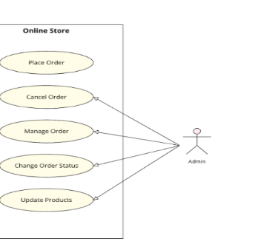

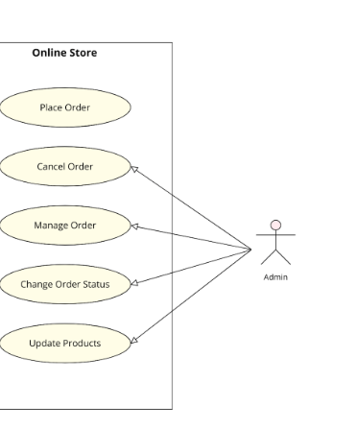
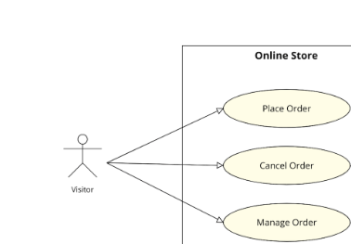
Use Case Diagrams
Exploring System Interactions
1
User Scenarios
Visual representation of the various interactions and relationships between system actors and use cases.
2 Functionality Mapping
Illustration of how users interact with the system to achieve speciﬁc functionalities and tasks.

Slide 9
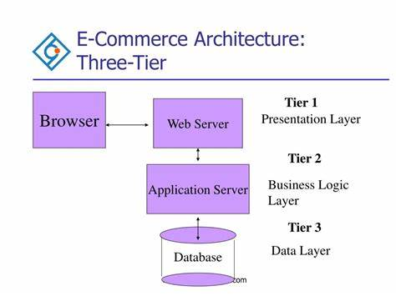
System Architecture
FootwearRedux adopts a layered architecture, including Frontend, Backend, and Database layers, ensuring maintainability, scalability, and eﬃciency for the platform.

Slide 10

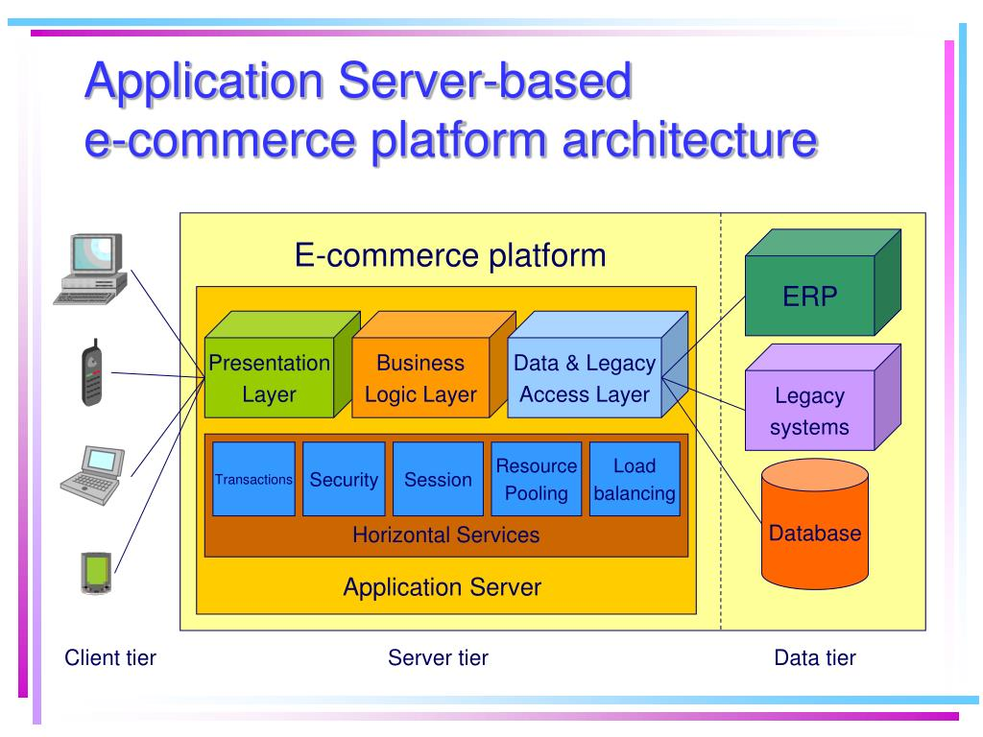
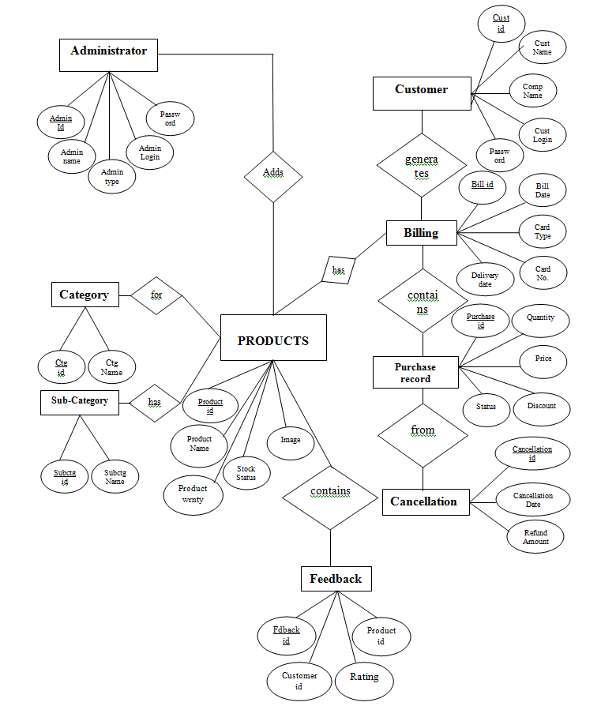
Design
Architectural & Diagrammatic Overview
General Architecture
Object & Class Diagrams
Illustration of the overall system architecture and the interrelation of different components.
Visual representation of the system's object structure and class relationships.

Slide 11
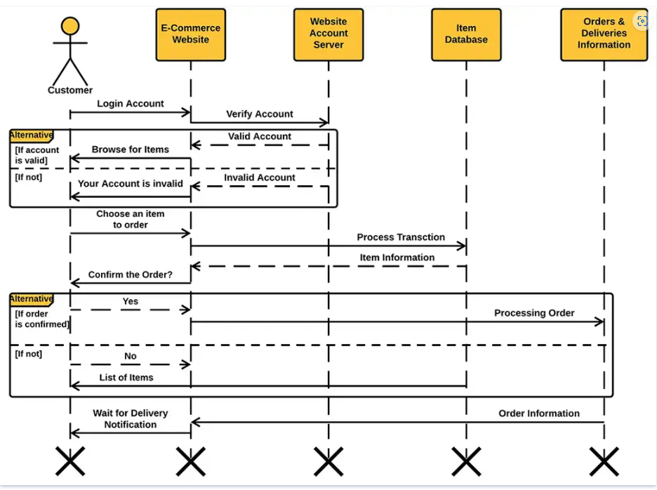
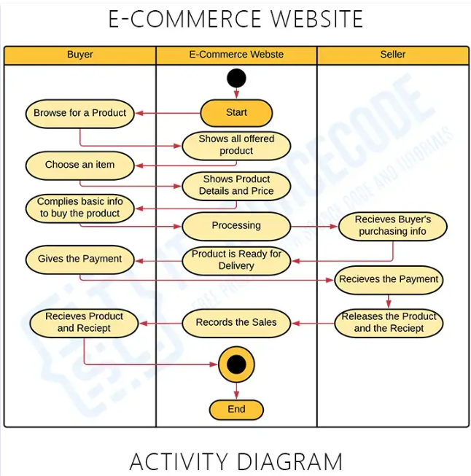
Interaction and activity diagrams

Slide 12
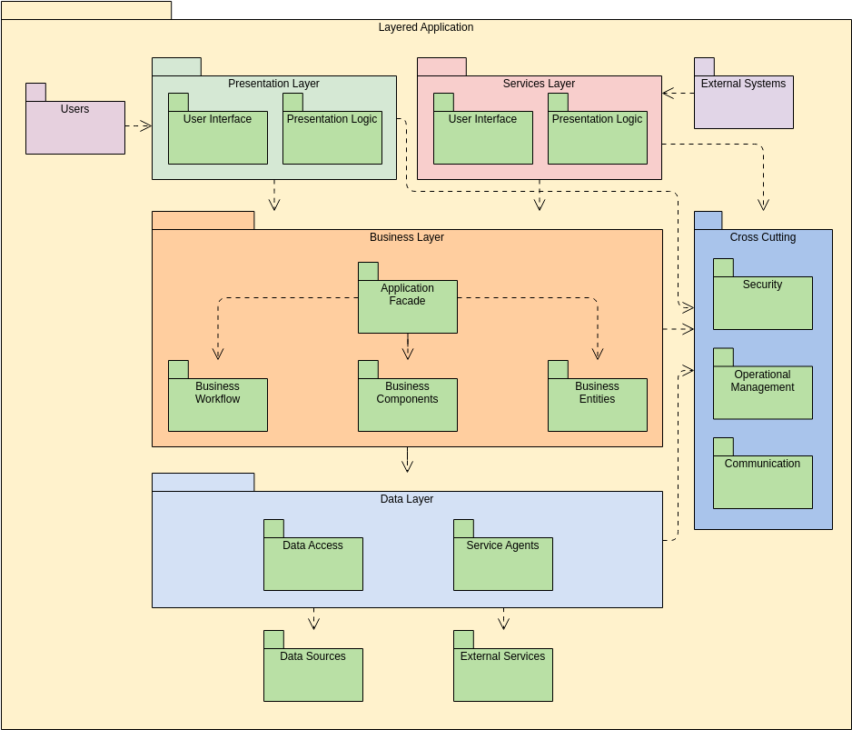
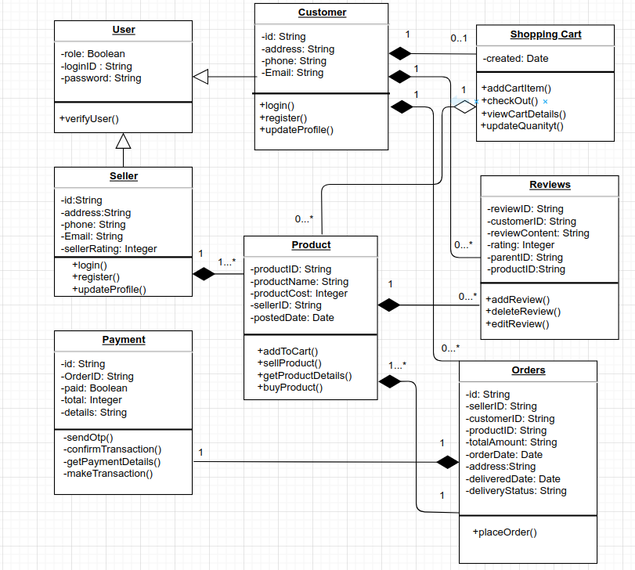
Package and class diagrams

Slide 13
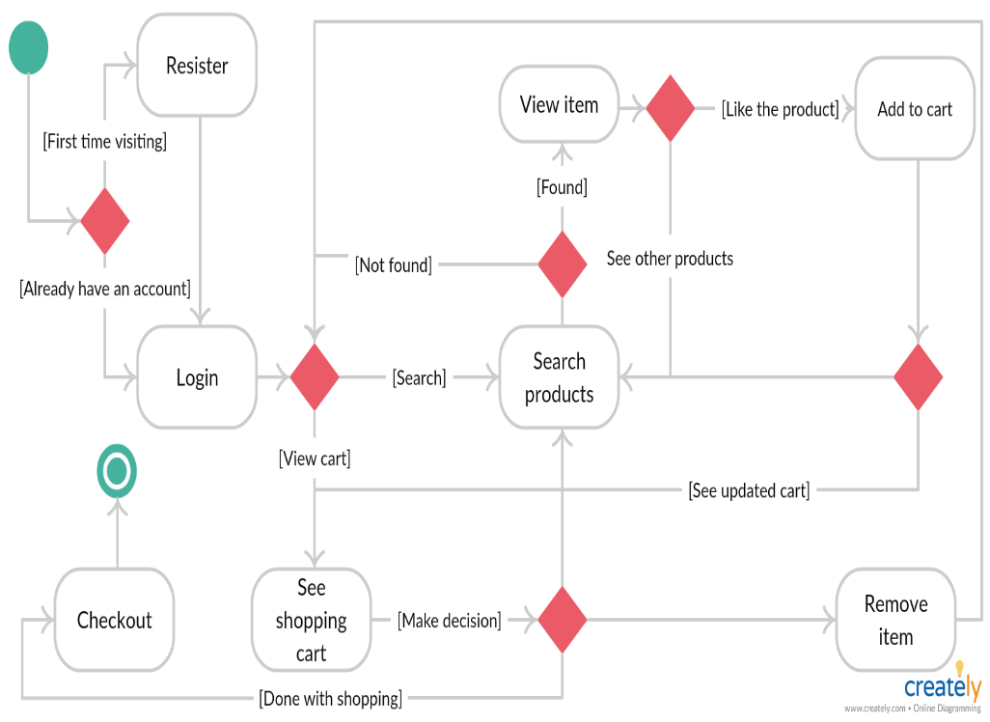
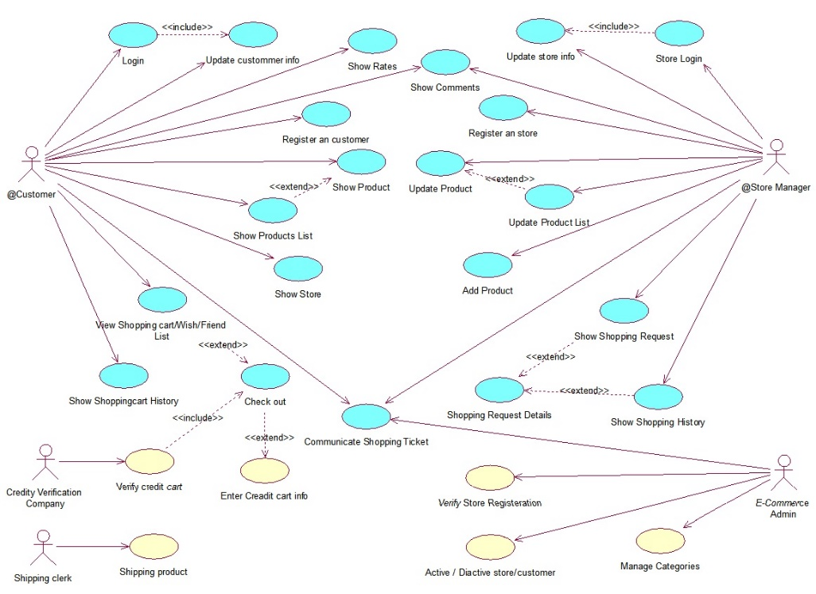
State diagrams

Slide 14
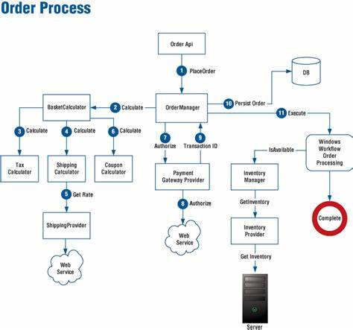
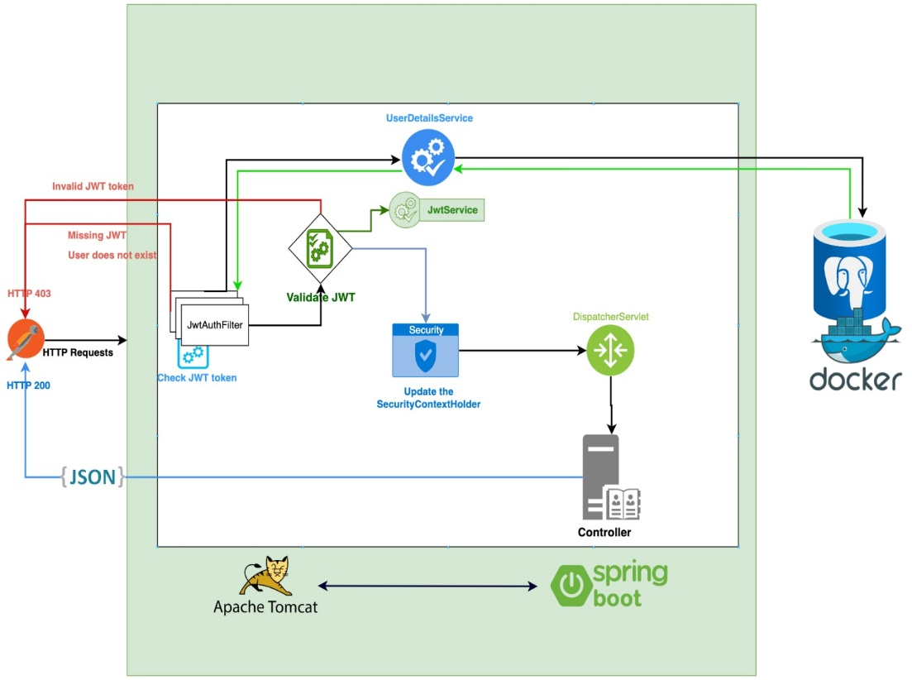
Some api functionalities

Slide 15
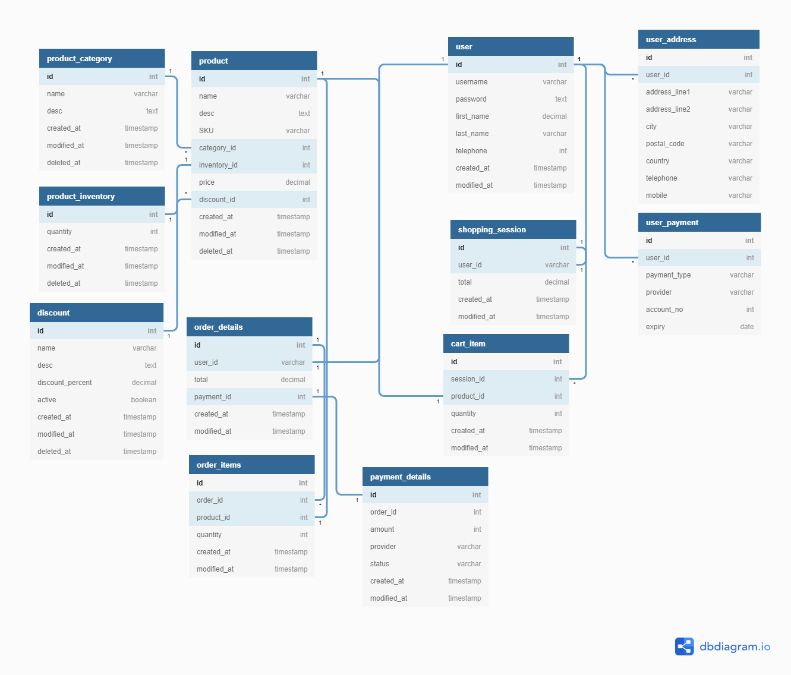
DB diagram

Slide 16
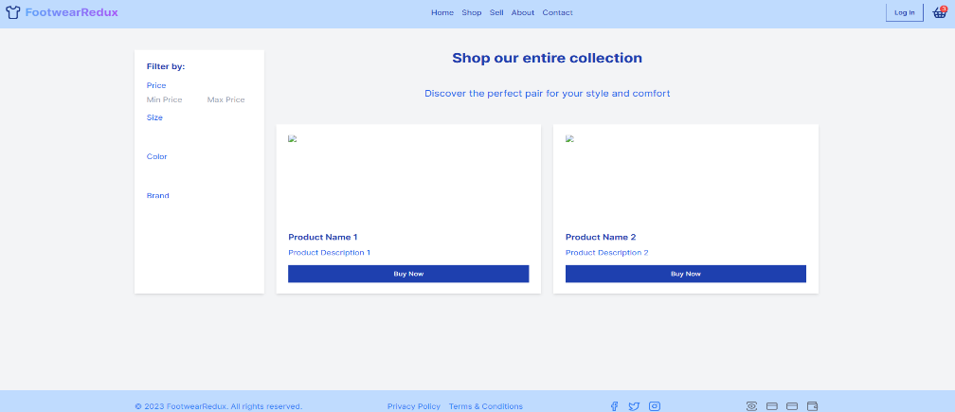
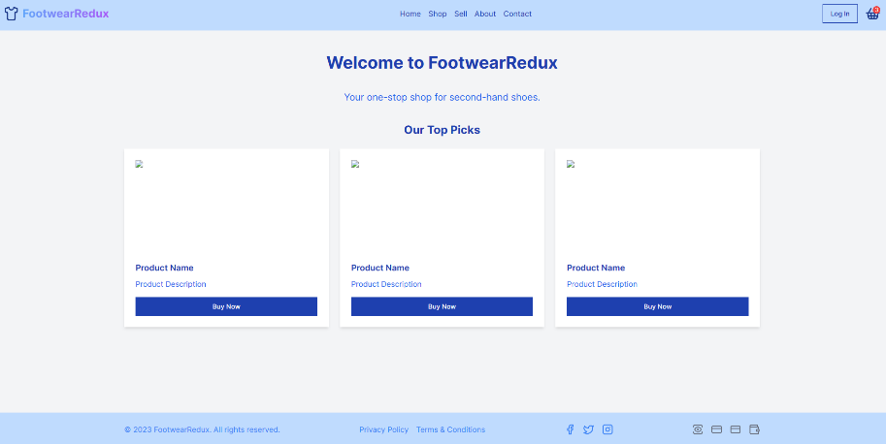
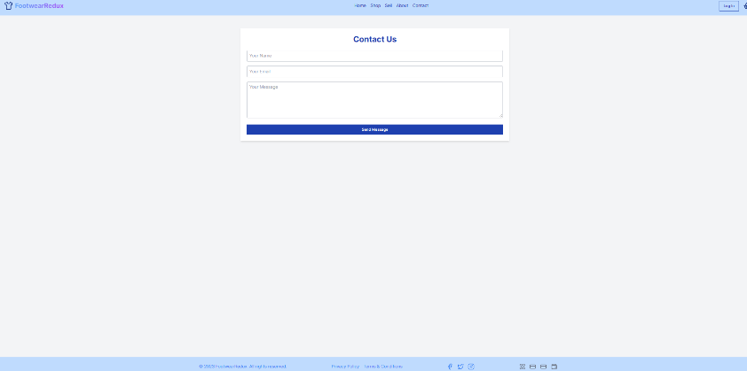
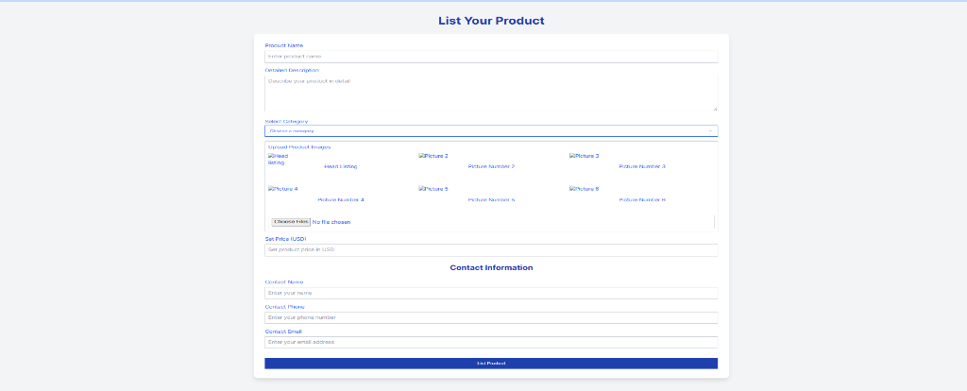
Operation Mode & UI
This section will include a presentation of FootwearRedux's operation mode, along with screen shots showcasing the user interface design and features.

Slide 17
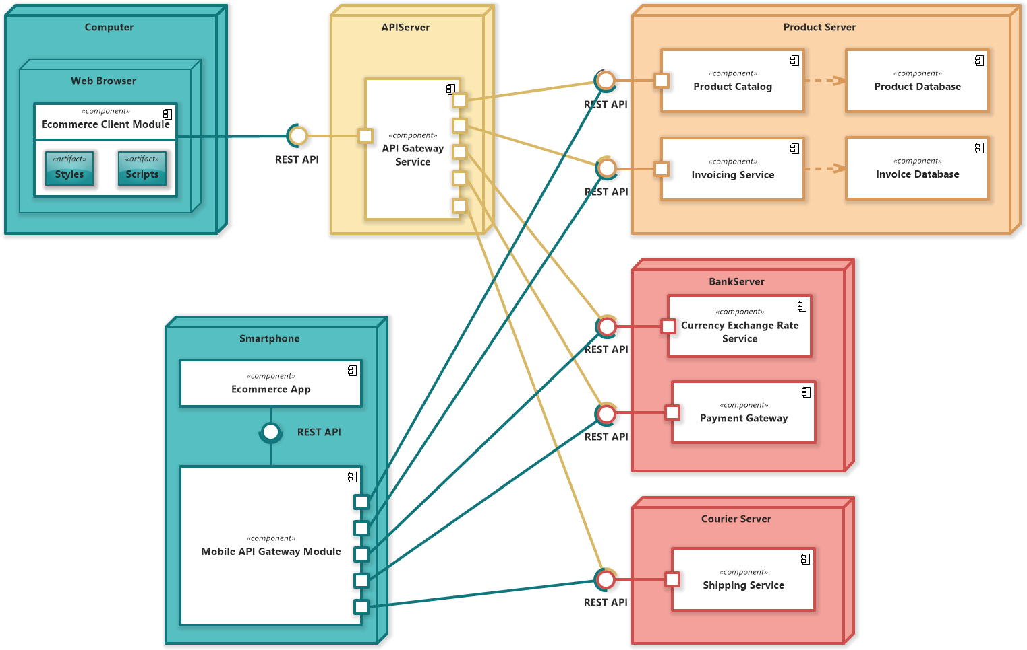
Portability
FootwearRedux exhibits a high level of portability, allowing it to be easily deployed and run across various environments and platforms. The project's portability ensures ﬂexibility, scalability, and eﬃcient operation in diverse deployment environments.

Slide 18


Competing Software
FootwearRedux competes with leading platforms like StockX in the pre-owned and new shoe market. However, its unique focus on sustainability, affordability, and
user-friendly experience sets it apart in the competitive landscape.

Slide 19
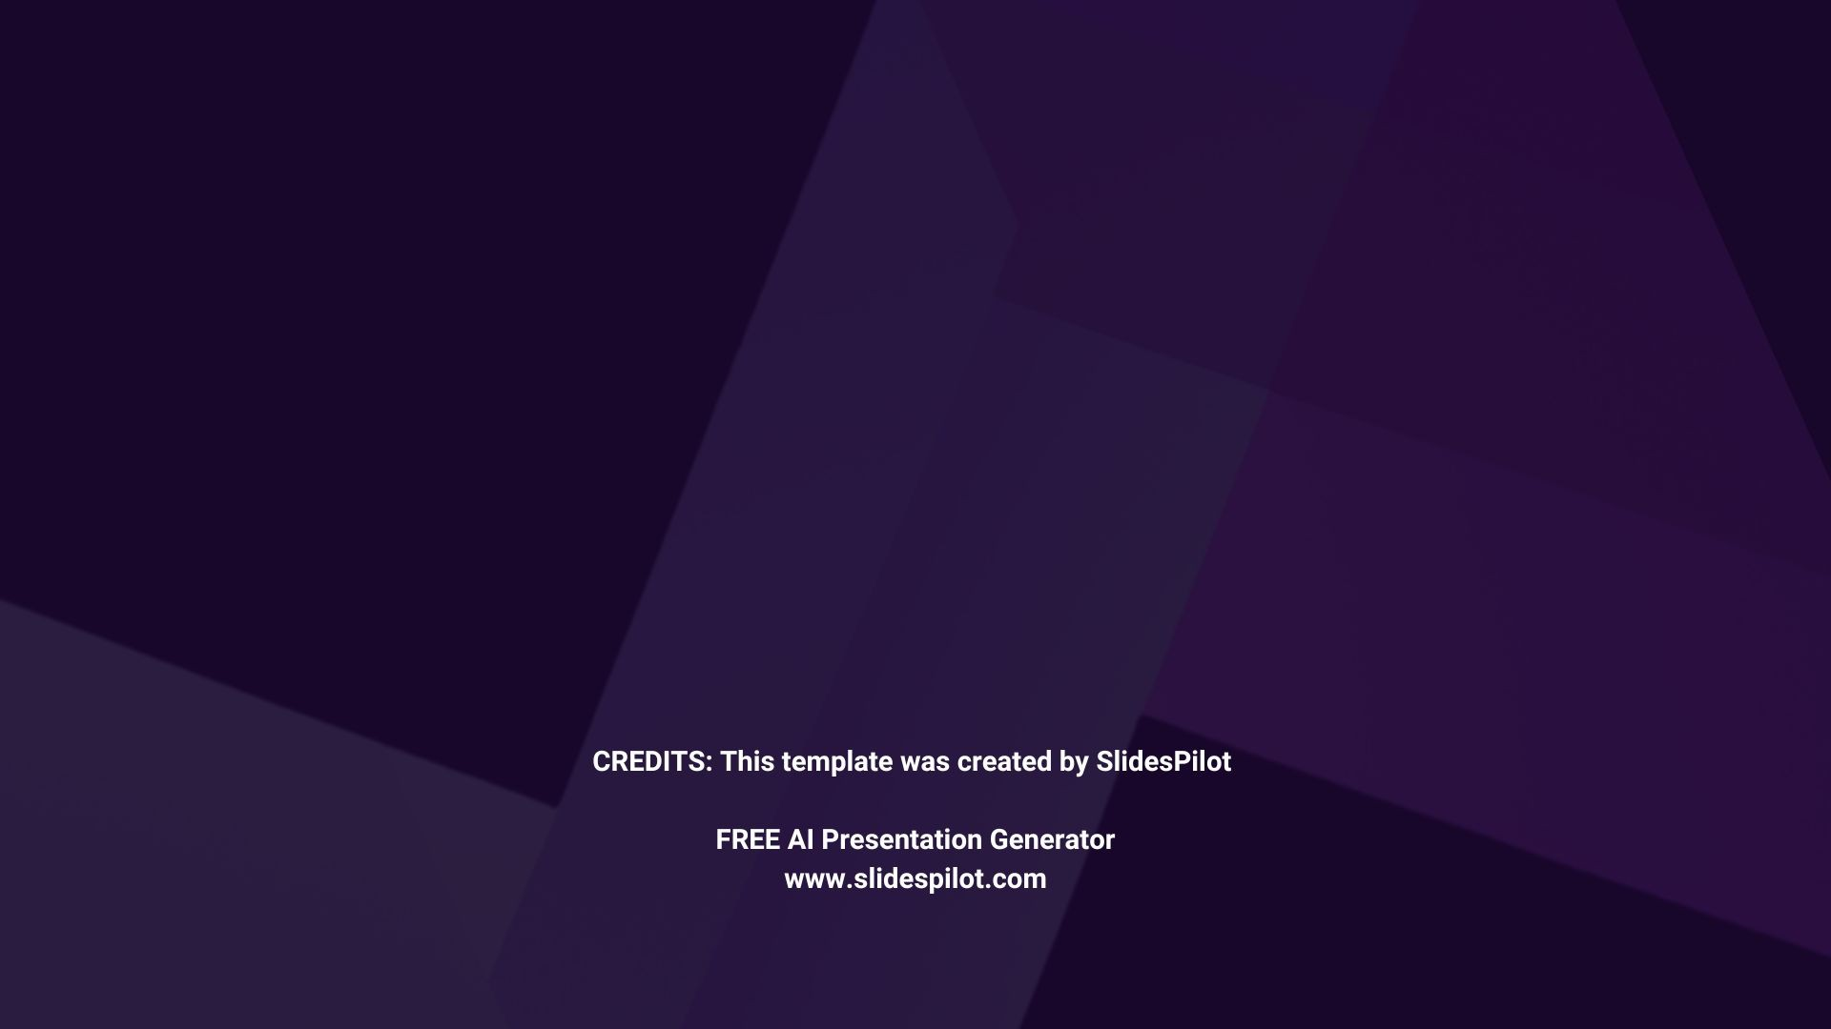

Thank You
Gelu-Samuel Josan Catalin Cot Group: 30431

